Slide 1
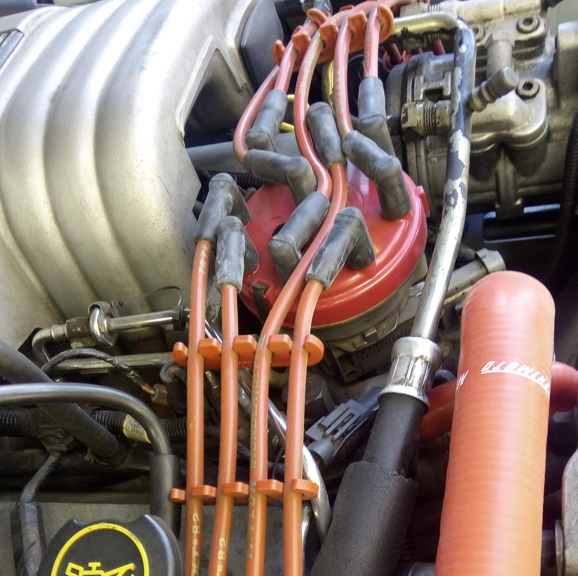
Case Study – Substitution
Believe it or not, some performance cars are still using high performance ignition wires.
How is it made?
Dr. Georgi Popov’s digital library
Dr. T. Popov Mustang

Slide 2
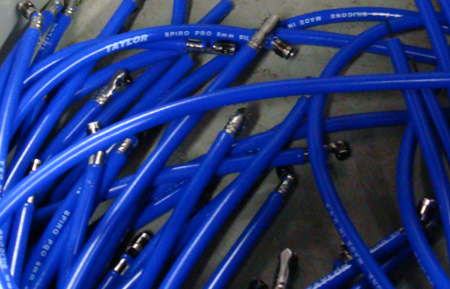

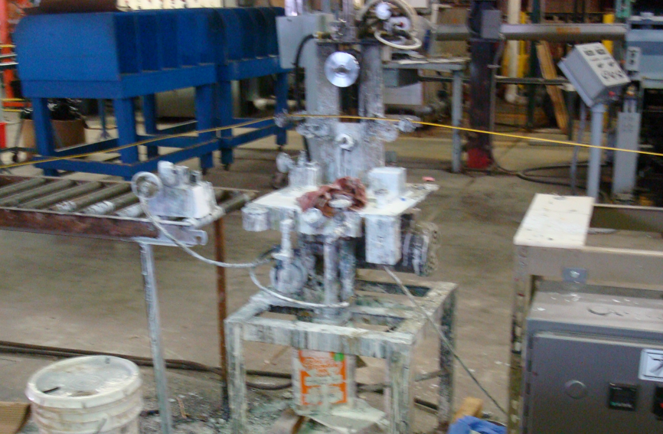
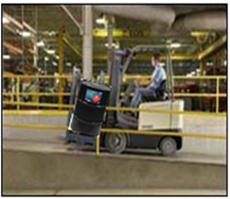
Case Study Risk Pathway Model
Automotive spark plug ignition wires
Fatalities, injuries, illnesses; property loss; business interruption; damage to reputation; loss of market share, non-conformance
Proximity of workers; contractors; public; building; air, water, soil
Top event
Hazards
Hazards (Chemical, physical)
Proximity to hazard
Potential for contact
Factors influencing risk
Immediate cause(s)
Loss of control
Resulting effects
Slippery floors; poor maintenance
Risk
Human error; faulty equipment, environment, process; poor management or supervision

Slide 3
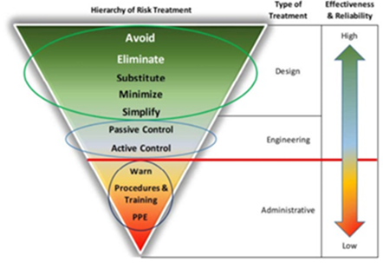
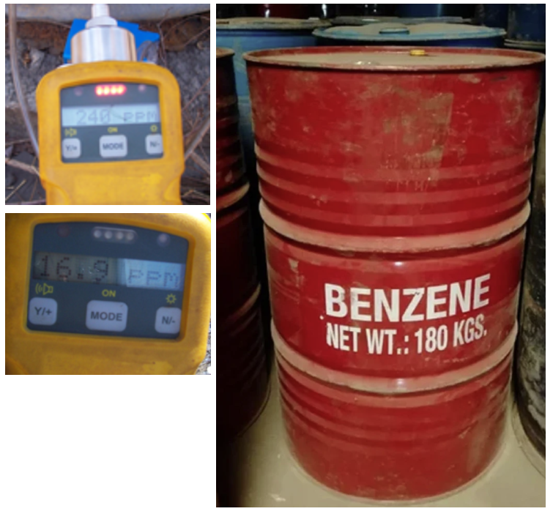
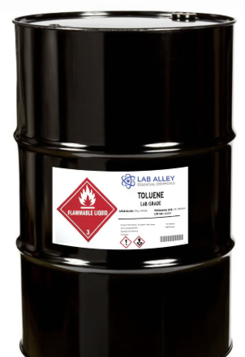
PtD Standard HoRT
Hierarchy of Risk Treatment Model reprinted with permission from ANSI/ASSP Z590.3-2021
Note. Courtesy of the American Society of Safety Professionals.

